Slide 1
Cúram Architecture Overview
Eamonn Moriarty 20/07/2012

Slide 2
Architecture Overview
Architecture History
Cúram Development Architecture
Cúram Online Architecture
Cúram Connector Architecture
Cúram Batch Architecture
Cúram Deployment Architecture
Notes:
2

Slide 3
Architecture History
1997 began developing Cúram 1.0
C++
CORBA (WebLogic Enterprise) Transaction Processing Monitor
Fat Java client built using VisualAge for Java.
Rational Rose – Model Driven Architecture from the beginning
1999 v1.0 released.
v1.6 was latest version on this platform.
2002 v2.0 released.
J2EE, thin client, etc.
2011 v6
July 2012 v6.0.3 (BlueWashed)
Notes:
3

Slide 4
Architectural Requirements
High volume, high user count transaction processing environment
Both online and batch
Ability to scale to cope with future transaction volumes
Government Customer Environments
Heterogenous Middleware, Operating System and Database Environments
IT Departments of variable sizes with dated skill sets
Trend towards Citizen Self-Service
Ease of deployment to large volumes of users
Requirement for flexibility and agility to cope with legislative and policy changes
Requirement for customer customization and configuration
Requirement to support customer upgrades
Notes:
4

Slide 5
Addressing Architectural Requirements
High volume, high user count transaction processing environment
Performant, N Tier J2EE architecture
Government customer environments
Open Standards to support heterogenous environments
Model Driven Architecture, technology independence and Code Generation to address customer skill sets
Dynamic Components to address both IT Department size and requirement for flexibility and agility in legislation and policy
Thin-client to address Citizen Self-Service and client deployment
Requirement for customer customization and configuration
Supported via Extension Mechanisms
Requirement to support customer upgrades
Also supported via Extension Mechanisms
Notes:
5

Slide 6
Cúram Development Architecture
Notes:
6

Slide 7
Development Architecture
Model Driven Architecture
UML-based application model
Java code generators produce significant portions of client/server applications
Simplified Java coding of handcrafted business logic
Simplified development of JSP-based User Interface
Simplified generate and build environment
Generation of build dependencies and classpaths

Slide 8
Customization vs. Configuration
A caveat on the Development Architecture!
In general, Cúram’s strategic direction is towards Configuration rather than Customization:
Configuration refers to defining of metadata, using the Cúram Administration Suite, to support specific business functionality
E.g. Rules, Evidence, Scripts, Citizen Portal, etc.
No development-time activity required (no Java!)
Customization refers to writing or extending code, requiring a development, test and deployment cycle
Cúram 6.0 provides many more configuration options

Slide 9
Development Architecture Client Code Generation
Developer creates UIM and adapts CSS pages
Cúram generator
Generates JSPs from the UIM and XML pages.
Creates the appropriate directory structure for the Web application.
Generates application configuration files
Notes:
9

Slide 10
Development Architecture Server Code Generation
Generation of:
Server Access Beans
Security
Exception Handling
Data Access Layer SQL
DDL
Web Services
Online and Batch processes
Etc.
Notes:
10

Slide 11
Development Architecture
Development Toolset
Java IDE (Eclipse, RAD) as the Development, Build and Debug environment
Rational Application Developer for UML Modelling
Ant for Build Scripts
Tomcat as Servlet Container for Development Testing
Oracle, DB2, H2 as Development Databases
Development Lifecycle
Model
Code
Generate
Build
Test

Slide 12
Development Architecture Customer Extensions
Suite of product External APIs per component
Customer ability to model new classes, database tables, screens, etc. New functionality can invoke, wrap, or replace Cúram functionality
Legacy Support for a number of extension mechanisms, including Inheritance (with or without replacement), Extension and Aggregation.
Most of these are discouraged from 6.0.3
Pre 6.0.3, these allowed customers to change Out of the Box Cúram behaviour without the need to change Cúram artefacts in-place
Cúram Development Compliancy Guide and Compliancy Tool to inform and check on customer adherence to standards

Slide 13
Cúram Online Architecture
Notes:
13

Slide 14
N-Tier J2EE Online Architecture
Notes:
14

Slide 15
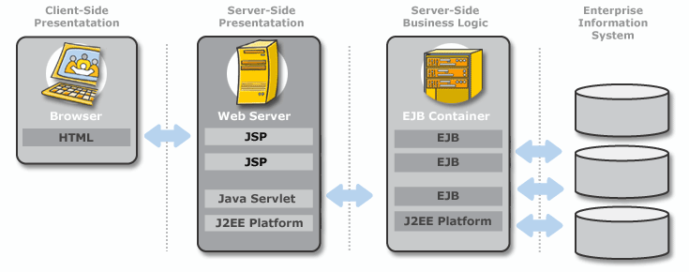
Employed J2EE Technology
JSP and HTML for presentation tiers
SAP NetWeaver/WebSphere Application Server/WebLogic Server
EJB Session Beans/Plain Java for business logic
Message Driven Beans for deferred processing and Workflow
JDBC for database access (no Entity Beans)
JMS for messaging and deferred processing
JTA for Transactions
JNDI for Naming Services
Notes:
15

Slide 16
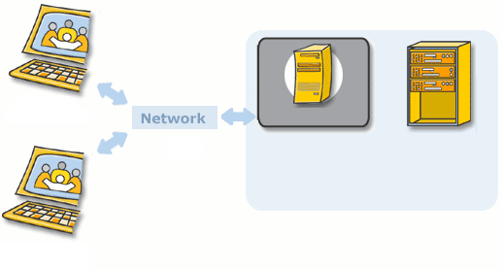
Client Online Architecture
HTML Pages generated from presentation layer independent XML screen definitions (User Interface Metadata or UIM)
Follows Sun J2EE Blueprints for Web Clients
Front Controller, Model View Controller II, Composite View (Struts)
Uses Dojo, Style Sheets to provide structure to the screen pages
User Interface (JSPs and HTML)
Data conversion
Pre-flight data validation
EJB interface management
Code Tables
Security
Notes:
16

Slide 17
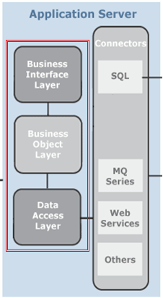
Server Online Architecture
Layered Approach:
Business Interface Layer
Handles interaction with Middleware
Business Object Layer
Layer in which Business Logic is generated/implemented
Data Access Layer
Handles interaction with RDBMS
Notes:
17

Slide 18
Server Online Architecture Business Interface Layer
Also referred to as Remote Interface Layer
Generated Middleware Abstraction Layer
Insulates Cúram developers from need to know details of specific Middleware platforms
Also allows Business Object Layer to focus on implementation of non-technology-specific business functionality
Controls:
Security (Authorization): Role-based; Security Identifiers granted to users; function, field, product, location, organisation levels. Authentication mechanisms, Single Sign-on via JAAS/App Server
Auditing: Before/After Imaging of database transactions, Business Interface Façade auditing
Logging: Log4J-based, property-controlled from basic to verbose
Exception Handling: last-chance handling, chaining of exceptions, automatic transaction rollback
Caching: Security, Codetables
Infrastructure calls for Transaction Handling: JTA
Notes:
18

Slide 19
Server Online Architecture Business Object Layer
Contains application business logic
“Process” objects contain business functionality
“Entity” objects perform data accesses
All business objects (process and entity) are created by calling factory methods
Entities, Entity Operations, Connector code all generated by Cúram Code Generators: CRUD operations and wrappers to hand-crafted SQL
Web Services wrappers for Process Class code
Web Services wrappers for external WSDL-specified Services
JMS connector generation
Developers specify Process and Entity classes in UML Model, together with relationships between them
Notes:
19

Slide 20
Server Online Architecture Data Access Layer
RDBMS Abstraction Layer
Insulates Cúram developers from need to know details of specific middleware platforms
Also allows Business Object Layer to focus on implementation of non-technology-specific business functionality
Data Access Object Pattern
Uses JDBC (Type 4 Driver)
Layer Generated by Cúram Handles RDBMS SQL differences
Generates Indicator value, host variables, etc.
Cúram generates all DDL necessary to create required database structures (tables, indexes, foreign keys)
For non-standard operations/database features:
Developers can specify their own SQL
Cúram UML model constructs for indexes, foreign keys, non-Null columns, non-standard operations, etc.
Notes:
20
Server Architecture – Business Interface Layer
The Business Interface Layer of a Cúram application controls various facets of client/server interaction. This layer deals with middleware concerns that are outside the focus of the application's business logic. Effectively this layer exists to shield business logic code from knowledge of its participation in a client/server environment.
Thus, the services of the Business Interface Layer are:
Business Object Life-Cycle management - creating/locating appropriate Business Objects to service client requests
Authorization - checking that a client is entitled to execute a particular server function
Transaction Control - starting, committing, and rolling back atomic transactions
Argument marshalling - translating between different data formats involved in client/server transmission
Last-chance exception handling - handling exceptions that are not properly handled by application code, and logging them to a central location, as well as performing uniform reporting to client applications.

Slide 21
Cúram Connector Architecture
Notes:
21

Slide 22
Connector Architecture
Interfaces to Legacy and Other External Systems
Accessing Web Services using Web services connectors
Using IBM MQ Series to access legacy systems
Exposing functionality using Web Services
JDBC connections to other RDBMS

Slide 23
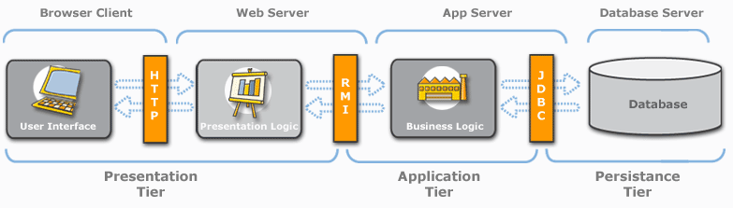
Connector Architecture
Web Service call from external system or from an Integration Backbone
Web Service or MQ call to external system or to an Integration Backbone

Slide 24
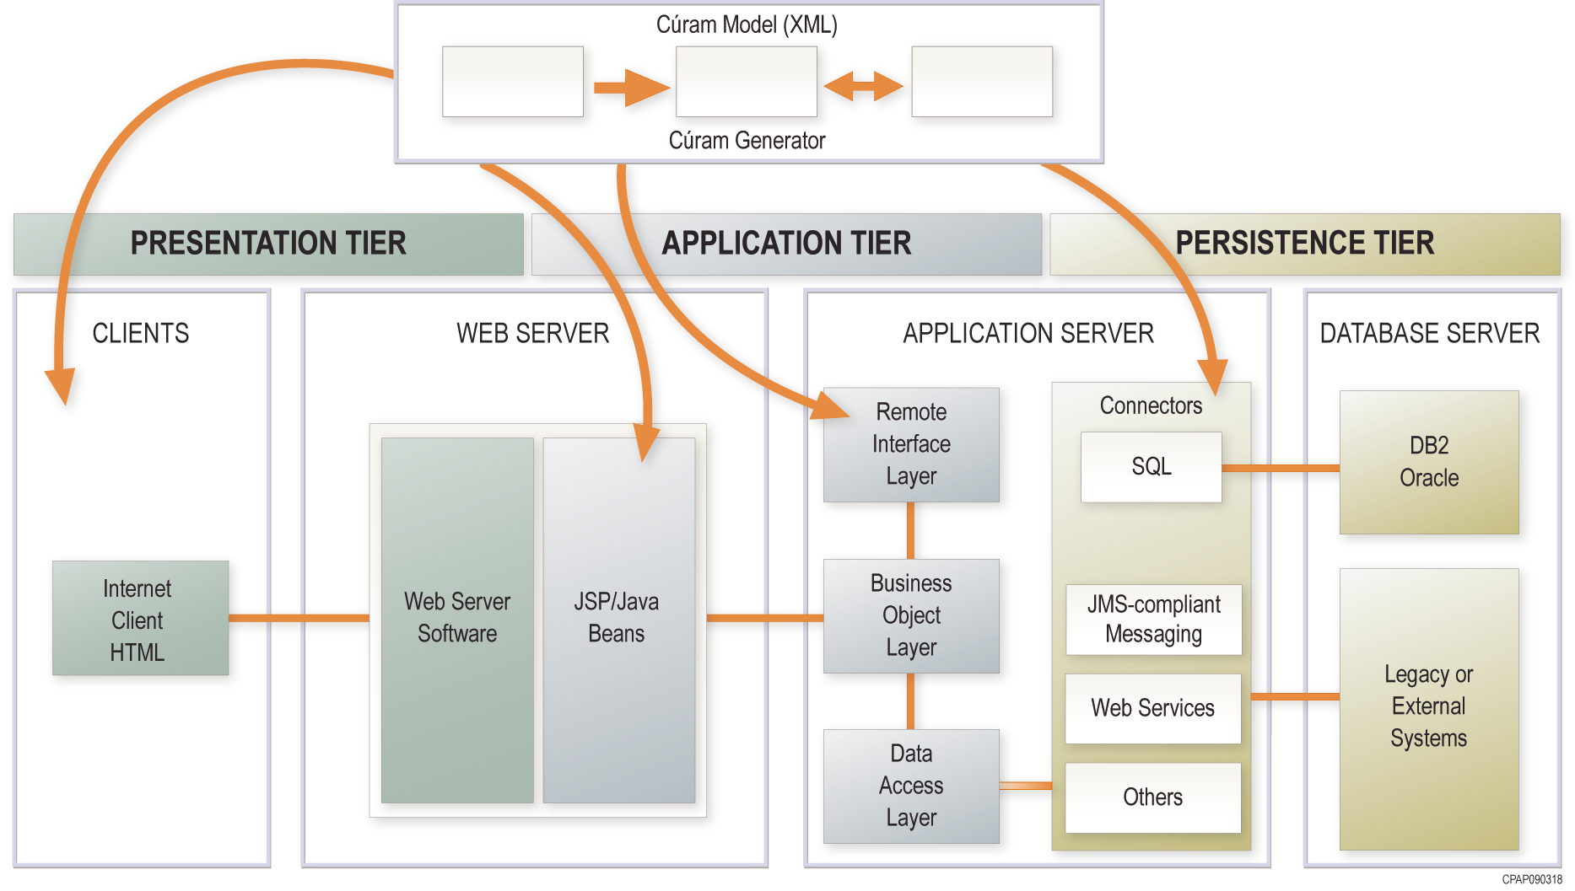
Integration Capabilities
Cúram supports a range of approaches to enable information exchange and system integration:
Web Services
Enterprise Application Integration (EAI) Connectors
Use of integration brokers
Data extracts/file imports
Cúram provides a connector framework which allows over 25,000 core processes
based on industry best practices to be used by external systems.

Slide 25
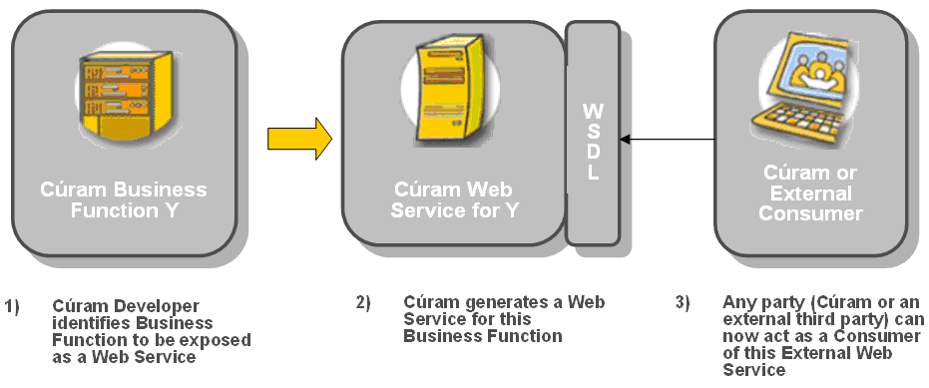
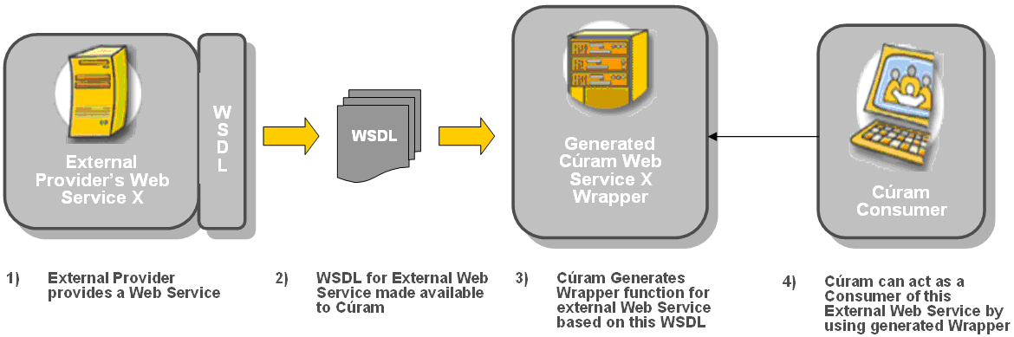
Cúram and SOA - Technical
Cúram as a Web Service Provider:
Supports Web Service standards required by the WS-I Basic Protocol and Basic Security Protocol (HTTP, SOAP, WSDL, XML Schema, WS-Security)
Supports Business process modelling standards for interoperability (WS-BPEL)
Generation of inbound and outbound Web Services
Cúram as a Web Service Consumer:

Slide 26
Cúram and SOA Overview
Cúram was (prior to acquisition) SOA Certified by IBM & SAP
Accepted to the IBM SOA Specialty at Connect level
Listed on the IBM SOA Business Catalog
Committed to SOA and additional certifications will be scheduled as appropriate
Cúram currently provides direct support for SOA
In a Business capacity
In a Technical capacity
Notes:
26

Slide 27
Cúram Batch Architecture
Notes:
27

Slide 28
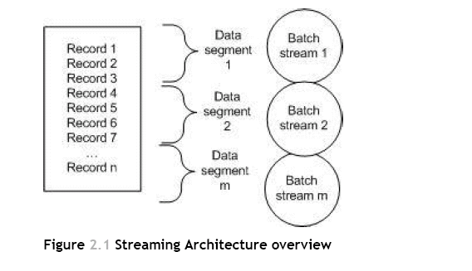
Batch Architecture
Scalable “Chunk and Stream” architecture
Multiple instances (Streams) of the same batch process can be run to process “chunks” of records
Chunk size and stream commit size configurable.
Each chunk is processed in a separate database transaction providing commit-point processing.
Notes:
28

Slide 29
Batch Architecture
Skip Processing - Records for which the business processing fails are skipped and processing continues for the remaining records in the chunk.
Highly Scalable - Multiple streams can be executed on one or more machines
Financial batch jobs utilize this architecture
Notes:
29

Slide 30
Cúram Deployment Architecture
Notes:
30

Slide 31
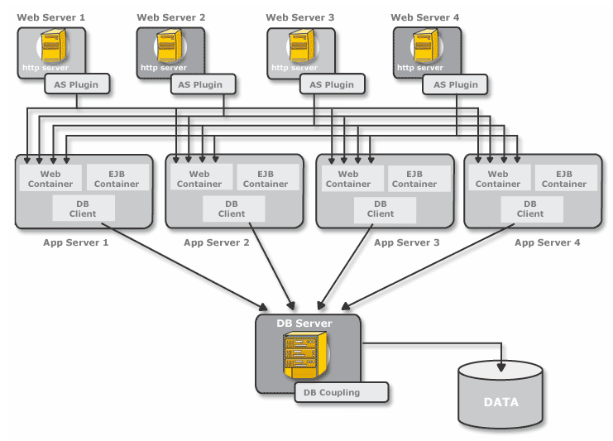
Deployment Architecture
Standard J2EE Deployment Architecture
Stateless Architecture
Both Horizontally and Vertically Scalable
Supports:
Hardware and Software Failover and Load Balancing
Database Coupling
Application Server Clustering
Notes:
31

Slide 32
Runtime Architecture
Supported Hardware and Software at: http://www.curamsoftware.com/support/v6.0_prereqs.html
App Servers: WebSphere WebLogic
RDBMS: Oracle, DB2 (+H2 for development)
Platforms: Windows, Solaris, HP-UX, Linux, z/OS
Support versions of third party products based on historic stability between versions
Three categories of support:
Forward Compatible: Customers are free to install version updates without them needing to be explicitly certified
Range of Versions: Customers can install any of a number of certified versions
Exact Version: Customers must install a single supported version

